Slide 1
E-commerce (Local Market)
Date-22/11/2021, Monday
Presented by
Govinda Kumar -2018kucp1137
Presented to
Dr. Parikshit Singh
Asst Professor, IIITKota

Slide 2
Introduction
E-commerce (Local Market) Definition
About our system

Slide 3
What is E-commerce
Commonly known as Electronic Marketing.
“it consist of buying and selling goods and service over an electronic system Such as the internet and other computer networks.”

Slide 4
Our System (Local Market)
Our system is an local market website from where people can buy product online at own nearest cities, village, town etc.
You can Identify the similar product in different shops
Admin monitors the activity of the users and check the transactions

Slide 5
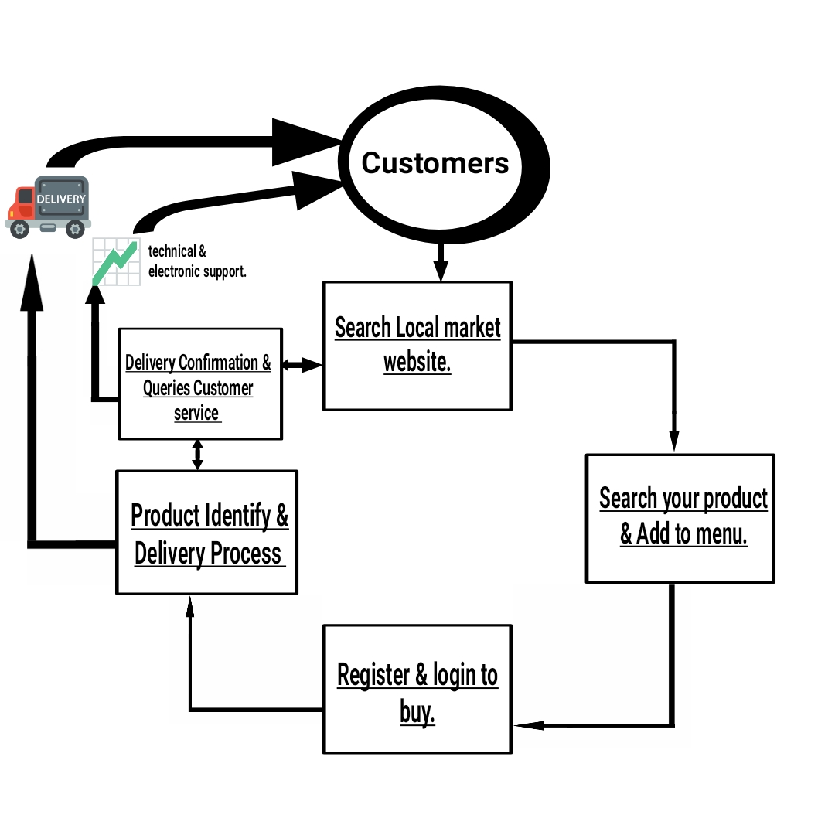
The Process of Local Market

Slide 6
Features:
Menu (Image of your city)
Catalog Browsing
~Category List
~Shop List
Login & Registration(Security)
Product browsing
~Product Reviews
~Related Product
Shopping Cart & Checkout
Auto generated bill
Payment Gateway
Customer Support

Slide 7
Languages: Tools :
HTML 5
CSS3
Bootstrap
PHP
MySQL
JAVASCRIPT
Photoshop
Sublime text
Xampp
Visual code editor

Slide 8
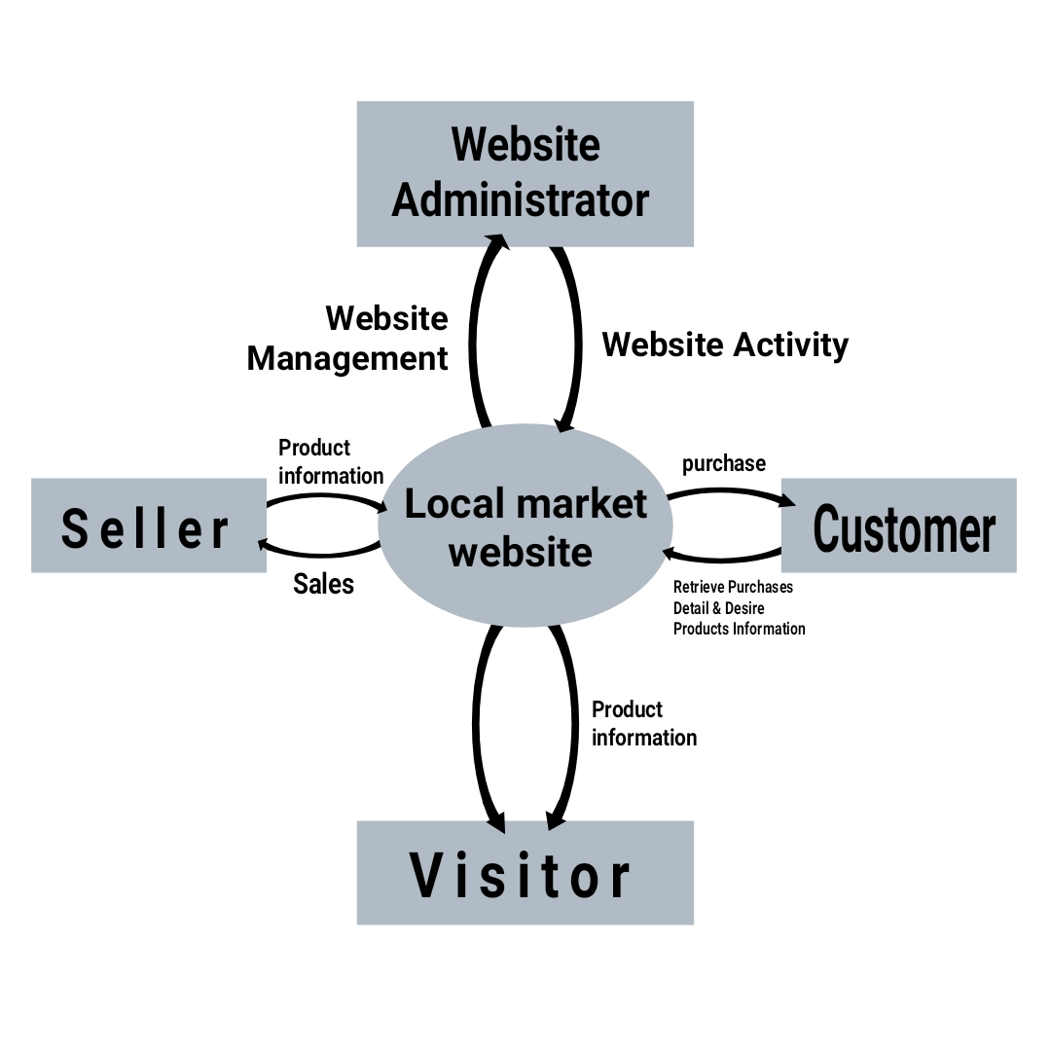
Data Flow Diagram

Slide 9
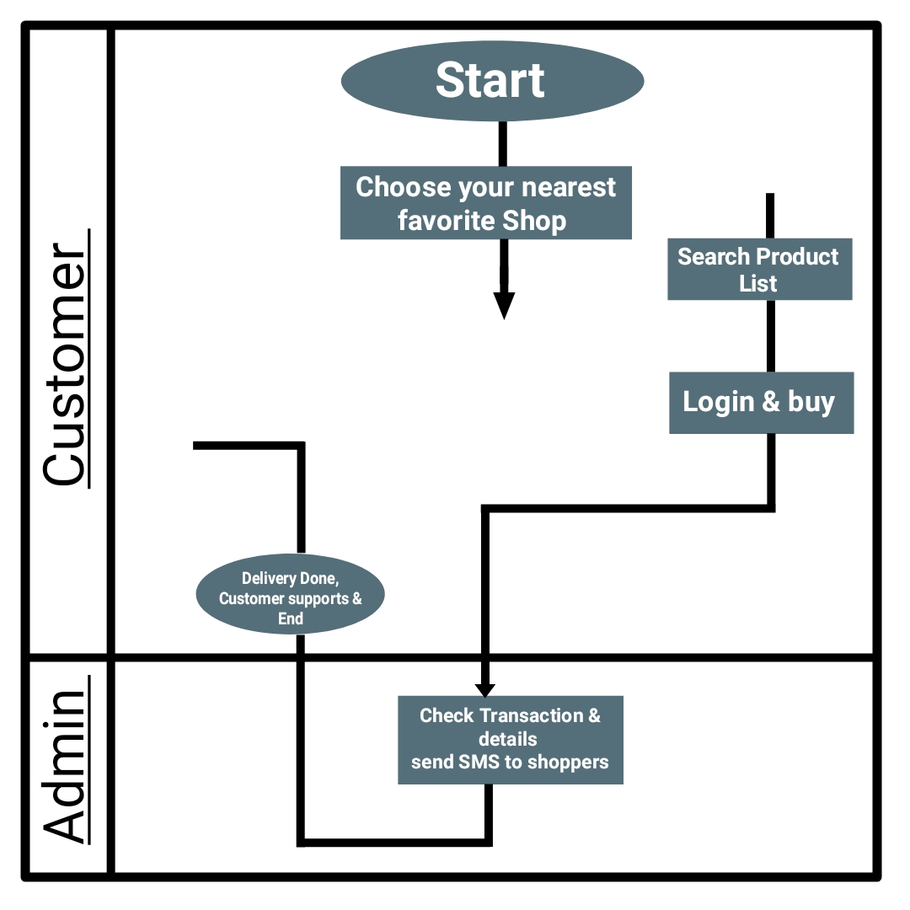
Business Process Model

Slide 10
ADVANTAGES OF LOCAL MARKET
You can buy product according to your demand at your nearest shop and contact him to delivery fast.
Buying/selling 12/7.
Payment option is given according to you either phone pay.
Job offer for delivery boy in your city.
We can widely add and remove shop.
You can ask for your product to directly shopper.

Slide 11
DISADVANTAGE OF LOCAL MARKET
Unable to examine products personally.
Website may be delay due to high crowd.
Not every is connected to the internet.
Need to required a website developer to manage the website.
Required some people to manage customers.

Slide 12
Future plan
We are thinking of some modifications and adding some advanced new features in out system. Some of them are.
GUI modification(more user friendly)
Payment option will modify for smoothly
Users can login using social media.
Some of state will join to sele/buy the product.etc

Slide 13
GUI (Graphical User Interface)

Slide 14
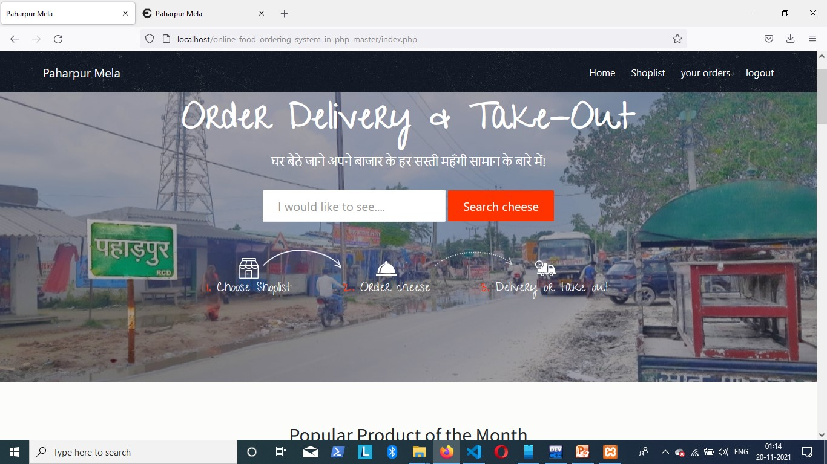
Home Page

Slide 15
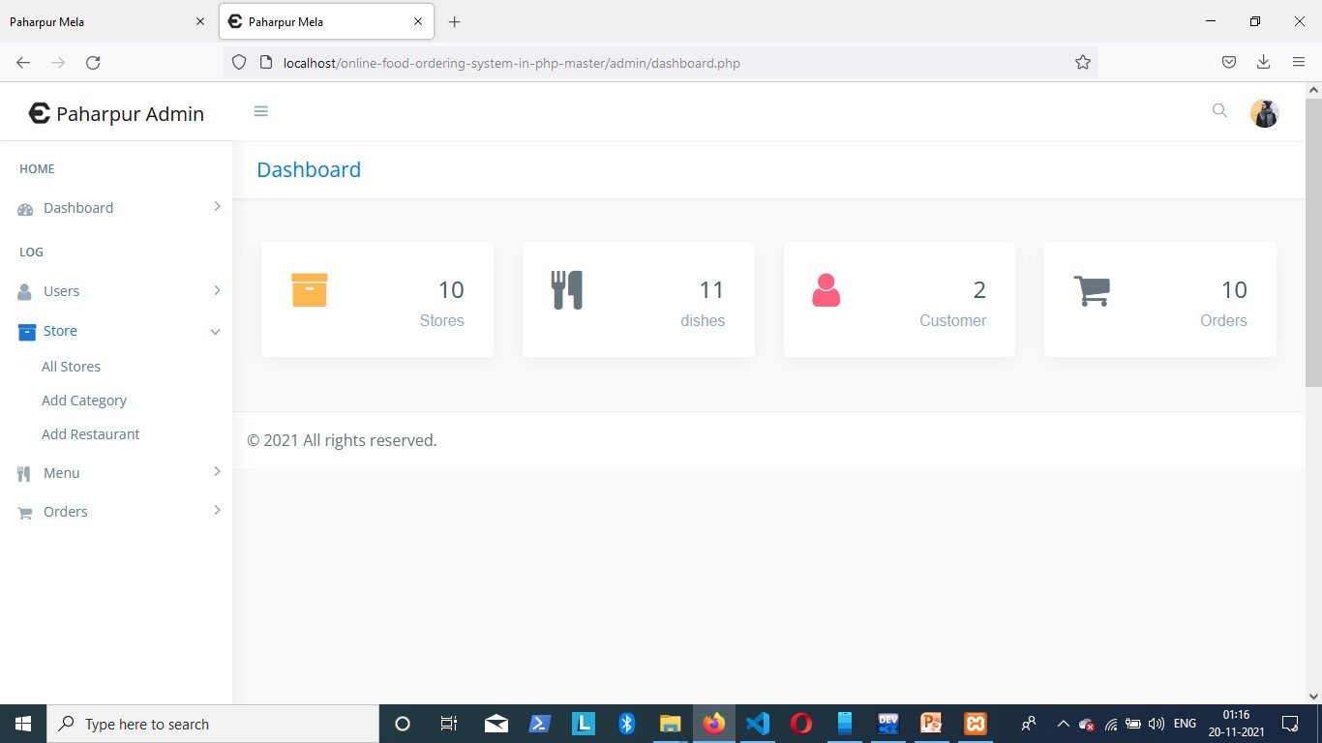
Admin panel

Slide 16
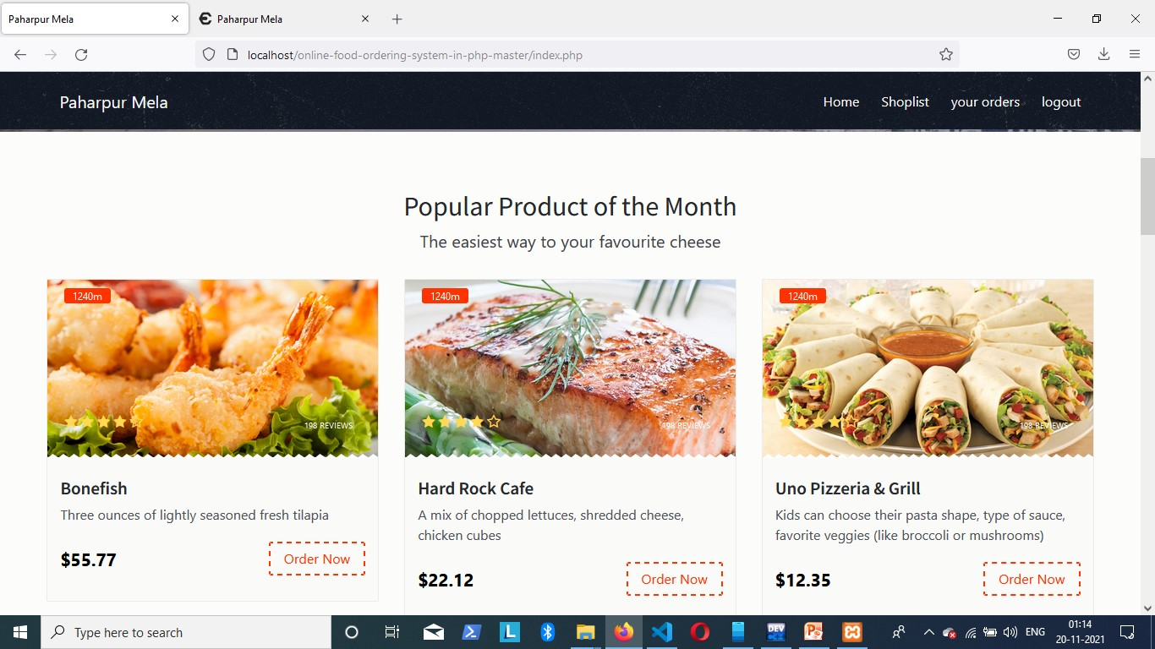
Product list

Slide 17
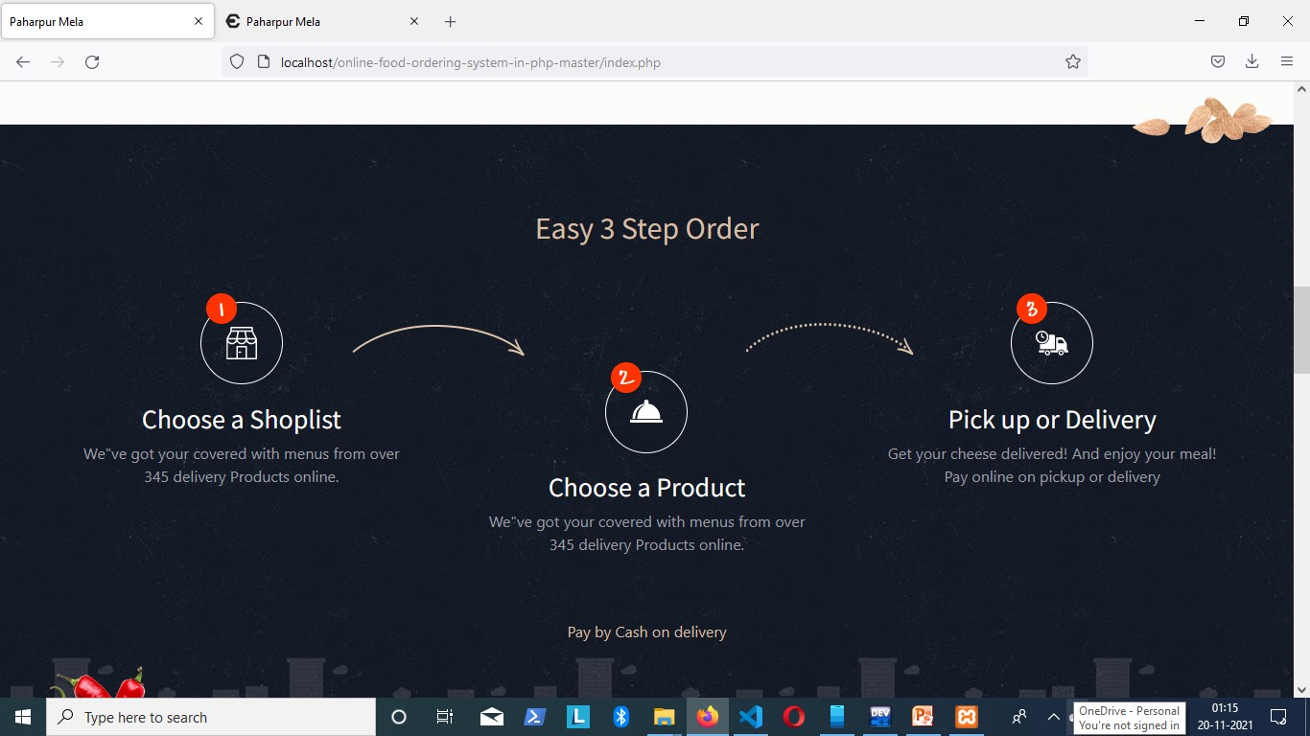
Process to buy

Slide 18
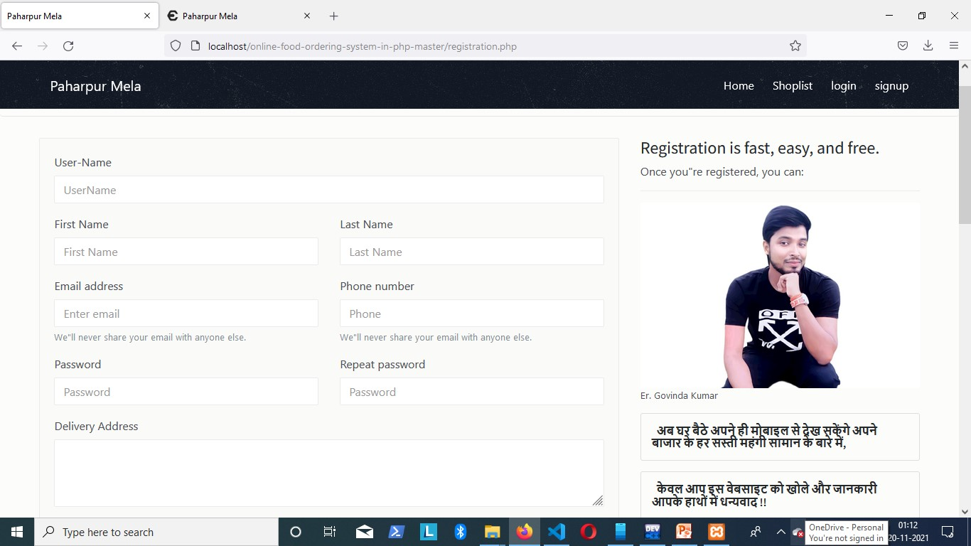
Registration & Login

Slide 19
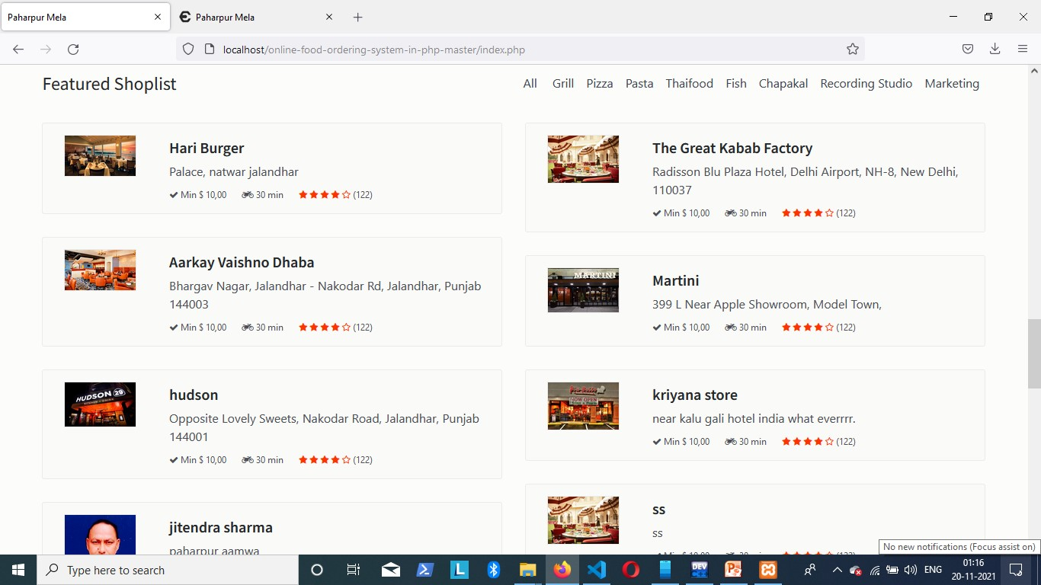
Shop list

Slide 20
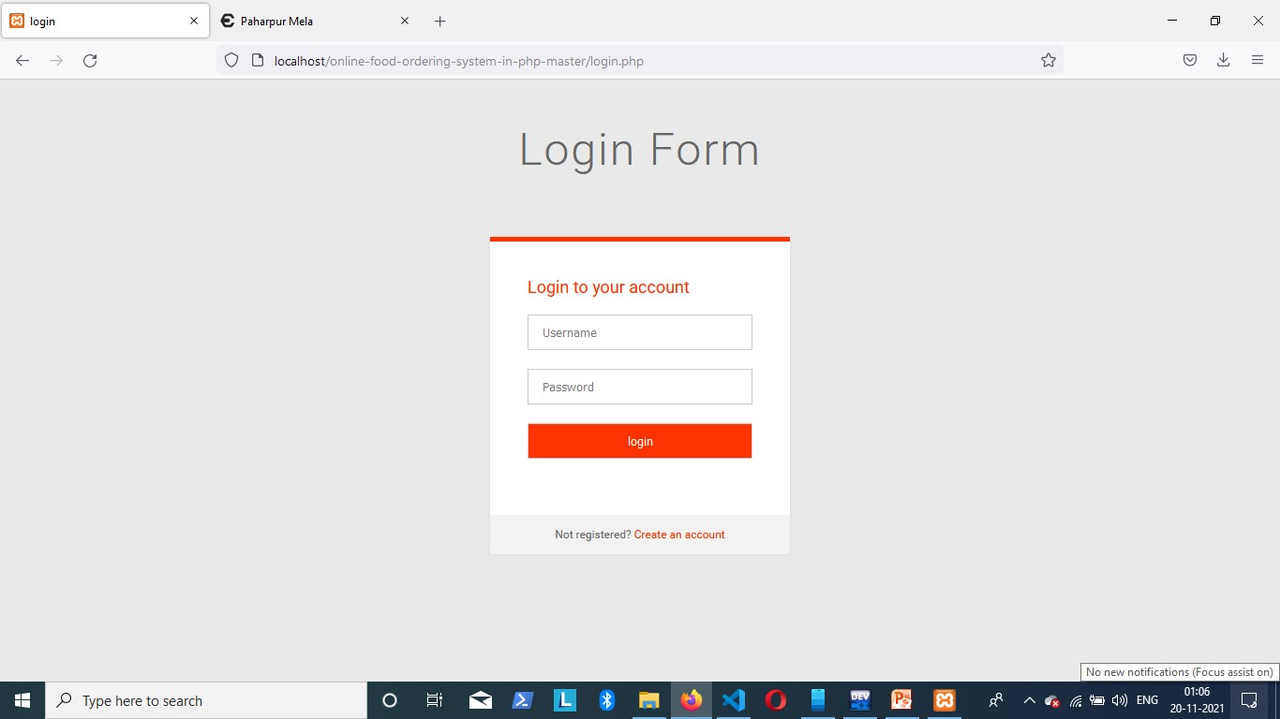
Login Form

Slide 21
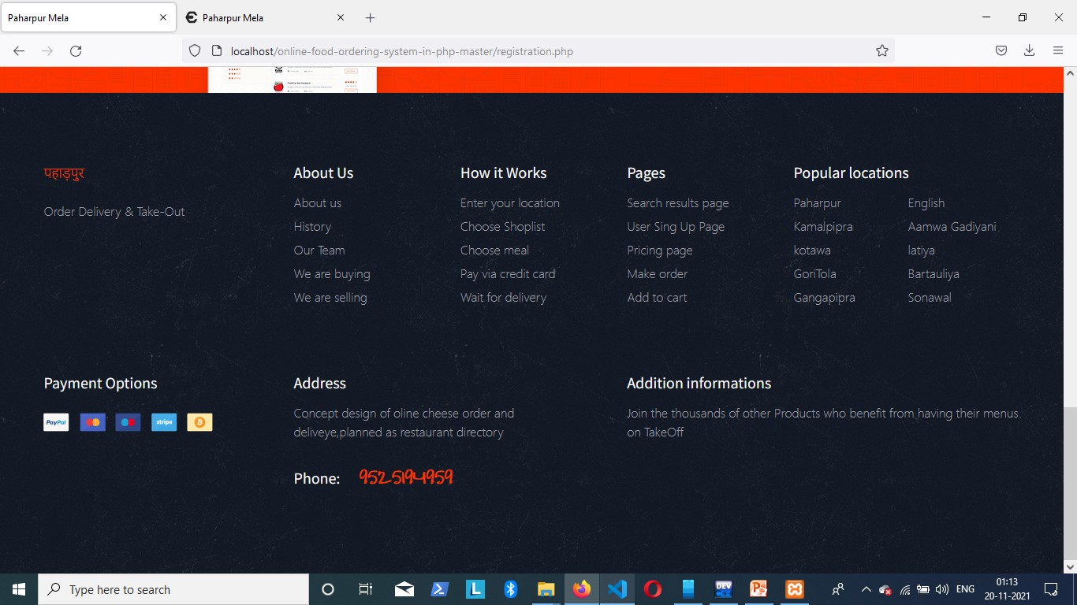
Footer

Slide 22
Query & Question ?
THANK YOU

